Slide 1







Financial Data Extractor & Reporter
By:Aditi Mandal

Slide 2



Introduction
Fetches cryptocurrency price data from CoinGecko API
2.Visualizes the price trend using matplotlib
3.Generates a plain English report using OpenAI's GPT-4 model

Slide 3

1. Data Extraction
Fetches 30 days of historical price data for Bitcoin (or other assets) from CoinGecko API
Processes the data into a pandas DataFrame with daily average prices
Key Features
2. Data Visualization
Creates a clean line chart showing the price trend over time
Includes proper labeling with title, axes, and grid lines
Saves the visualization as "trend.png"

Slide 4
3. Report Generation
Calculates percentage price change over the period
Uses OpenAI's GPT-4 to generate insights about:
Potential reasons for the price trend
Investment recommendations (buy/hold/sell)
Presents the analysis in simple English

Slide 5

Technical Implementation
Dependencies
Python libraries: requests, pandas, matplotlib, openai, datetime
CoinGecko API for cryptocurrency data
OpenAI API for natural language generation
Error Handling
Includes try-catch blocks for API calls
Provides meaningful error messages
Configuration
Easy to modify parameters (asset, currency, time period)
API key management through Google Colab secrets

Slide 6

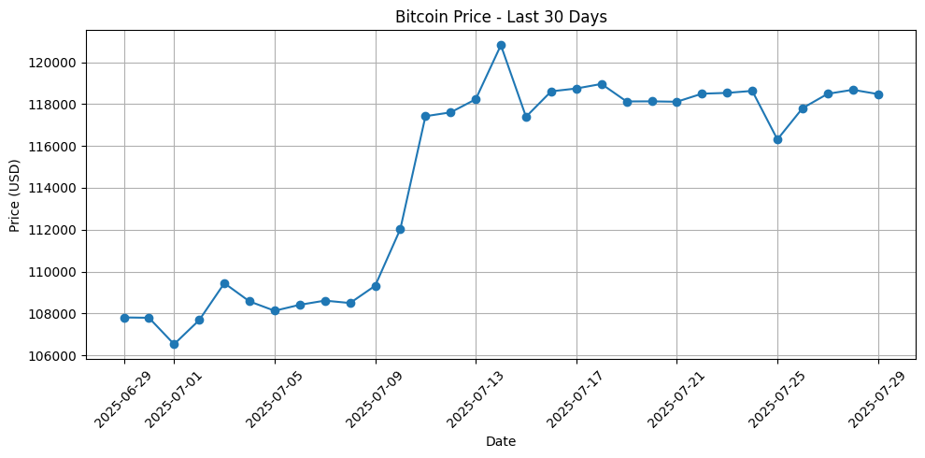
Case Studies and Real-World Examples

Slide 7

Conclusion
This tool provides a solid foundation for financial data analysis and reporting. With the OpenAI API authentication fixed and some additional enhancements, it could become a valuable resource for tracking cryptocurrency trends and generating investment insights.

Slide 8

Thank
You

